Slide 1
State-of-Health (SOH) Estimation of Lithium-Ion Batteries Using Two-Stage Autoencoder and BPNN
Pipeline Pre-processing & Autoencoder Validation
台灣科技大學 AI所
指導教授： | 羅一峰 博士
學生： | 林志龍 (M11452803)
Scientific Reports (2025) 10.1038

Slide 2
Outline
Dataset Overview
Spatial Pre-processing (Data Interpolation)
Feature Selection (Intrinsic Dimensionality)
Autoencoder Spatial Performance
Diagnostic of Latent Space
Root Cause Analysis (Proving the Hypothesis)
Next Steps (Moving to BPNN)

Slide 3
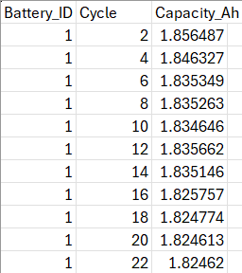
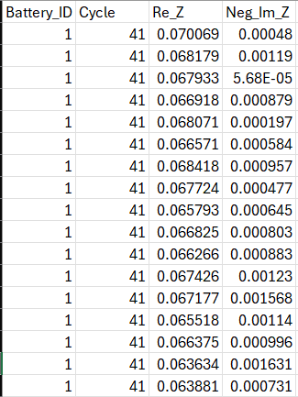
Dataset Overview
Limited Scope: Most existing reviews focus solely on single-cell estimation.
Battery ID | Total Cycles | Total Impedance Records | Initial Capacity (Ah) | Final Capacity (Ah)
B0005 (1) | 614 | 10,842 | 1.85 | 1.32
B0006 (2) | 614 | 10,842 | 2.03 | 1.18
B0007 (3) | 614 | 10,842 | 1.89 | 1.43
B0018 (4) | 319 | 2,067 | 1.85 | 1.34
Data Source: We are using 4 lithium-ion batteries from the NASA dataset.
Data Types: The dataset records Electrochemical Impedance Spectroscopy (EIS) and Capacity (Ah) for each cycle.
Objective: Our AI pipeline uses the Impedance records to predict this exact capacity drop (State of Health - SOH).

Slide 4
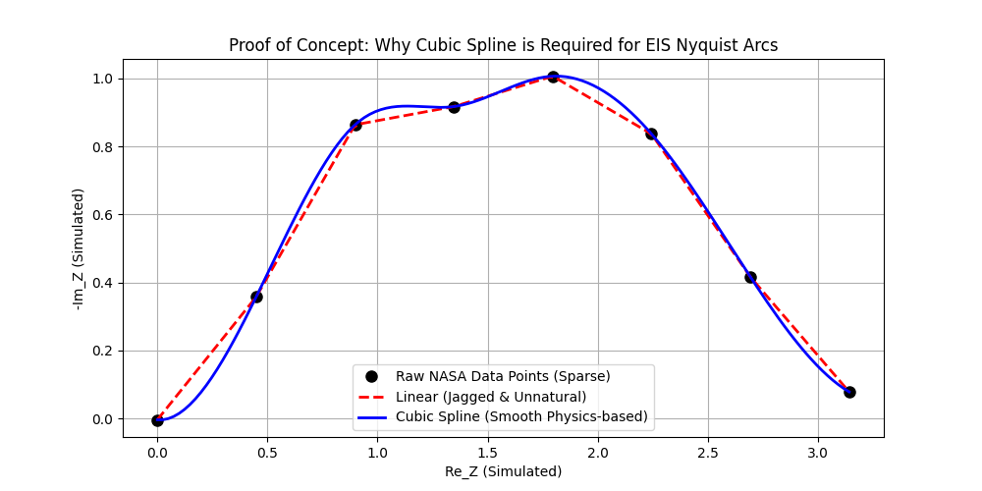
Spatial Pre-processing
(Data Interpolation)
Step 1: Physics-Based Data Interpolation
Goal: Resize raw data to 256 features (16x16) for the Autoencoder.
Problem: Linear interpolation creates artificial jagged edges (noise).
Solution: Used Cubic Spline interpolation.
Result: Preserves the true physical shape of the electrochemical Nyquist arc.

Slide 5
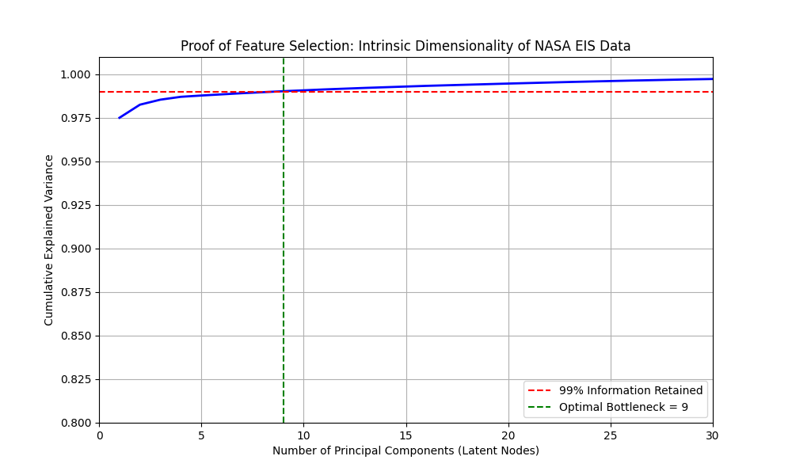
Feature Selection (Intrinsic Dimensionality)
Step 2: Finding the Optimal Bottleneck Size
Goal: Find the exact number of latent nodes needed for the Autoencoder.
Method: Principal Component Analysis (PCA).
Result: 9 components retain 99% of the original variance.
Conclusion: Bottleneck size is mathematically set to 9. Using 20 nodes causes redundancy.

Slide 6
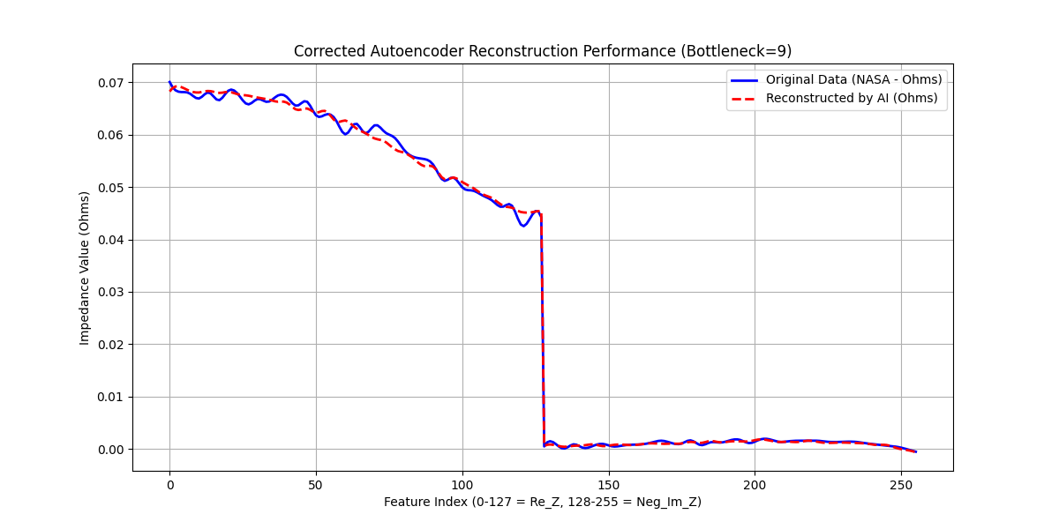
Autoencoder Spatial Performance
Step 3: Autoencoder Reconstruction Results
Model: Standard Autoencoder (9 Latent Nodes).
Result: The reconstructed signal (red) perfectly matches the original signal (blue) within 1 cycle.
Conclusion: The AE compresses and rebuilds the spatial features without data loss.

Slide 7
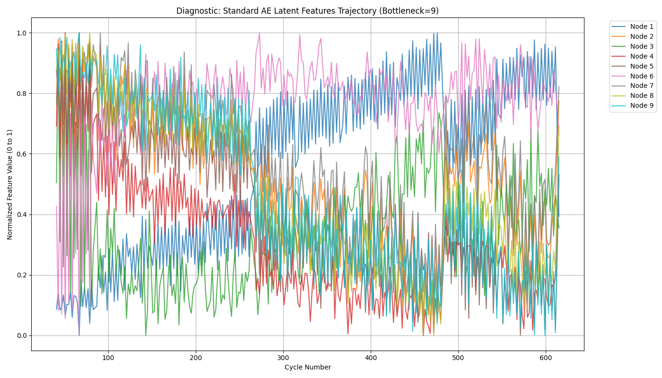
Diagnostic of Latent Space
Step 4: The Temporal Jitter Issue
Observation: The 9 latent nodes show high-frequency "sawtooth" patterns over time (cycles).
Analysis: The Autoencoder is a stateless spatial model. It processes one cycle at a time.
Hypothesis: The jitter is not a model error. It comes directly from the raw data.

Slide 8
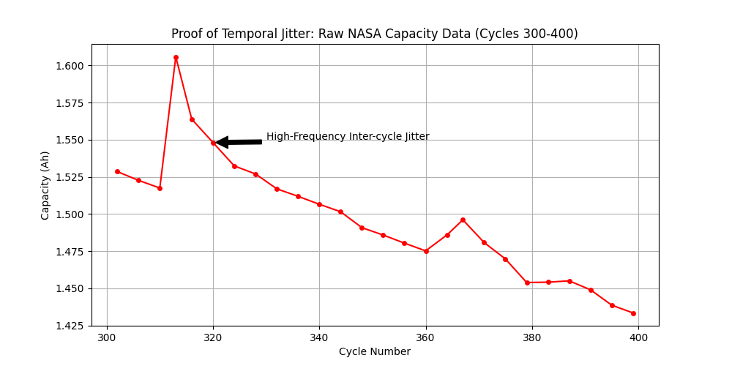
Root Cause Analysis (Proving the Hypothesis)
Root Cause: Inherent Dataset Noise
Evidence: Zooming in on the raw NASA Capacity data (Cycles 300-400).
Fact: The raw data inherently jumps up and down between cycles (Rest time recovery, sensor error).
Conclusion: We cannot use "Moving Average" to fix this, as it causes Data Leakage (using future data).

Slide 9
Next Steps (Moving to BPNN)
Next Steps: Handling Temporal Noise in BPNN
Current Status: AE Pipeline (Stage 1) is fully verified and locked (Bottleneck = 9).
Next Phase: Train the BPNN (Regression model) to find the global SOH trend.
Strategy:
  Use a Shallow Network to avoid memorizing the sawtooth noise.
  Apply L2 Regularization (Weight Decay) to force the model to find the smooth monotonic degradation trend.

